Slide 1
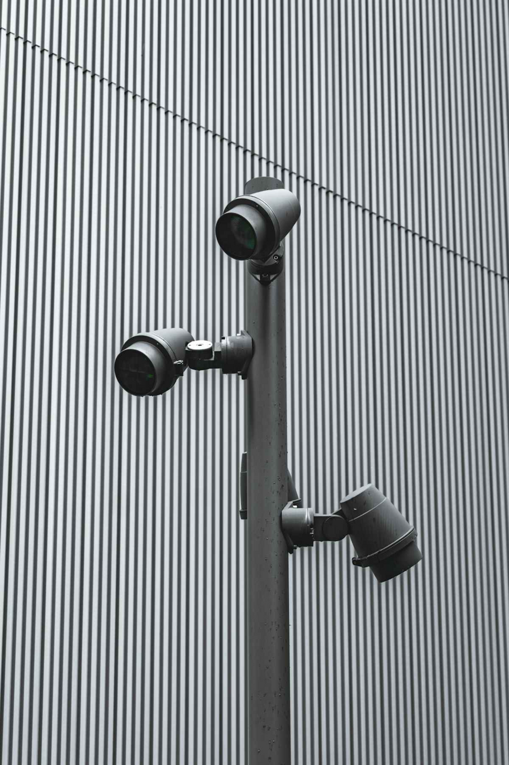
Violence Detection System using CNN-LSTM Models
Rahul Mishra, Anil Paneru, Mahesh Karki
Supervisor: Mr. Abhishek, Assistant Professor
Panipat Institute of Engineering & Technology, Kurukshetra University
Notes:
1

Slide 2
Project Aim & Objectives
Our primary objective is to develop an automated, real-time violence detection system for video streams.
1
2
Real-time Video Analysis
CNN-LSTM Integration
Process live video feeds to identify violent incidents as they occur.
Leverage the power of Convolutional Neural Networks (CNN) for spatial feature extraction and Long Short-Term Memory (LSTM) networks for temporal analysis to understand dynamic actions.
3
4
Automated Alerting
Data Logging
Generate immediate alerts upon detection of violent activities, enabling rapid response.
Record incidents and relevant metadata for forensic analysis and continuous system improvement.
Notes:
2

Slide 3

Methodology: The Detection Pipeline
Our system processes video sequentially, combining spatial recognition with temporal understanding to identify violent events.
Video Input
Frame Extraction
CNN Spatial
LSTM & Prediction
This integrated approach allows for robust analysis of both individual frames and the sequence of actions over time.
Notes:
4

Slide 4
Hardware and Software Requirements
Software Stack
Hardware Specifications
Python 3.x
Multi-core CPU (Intel i7/AMD Ryzen 7 or higher)
TensorFlow / Keras (Deep Learning Frameworks)
16GB+ RAM (for efficient data handling)
OpenCV (Video Processing)
NVIDIA GPU (e.g., RTX 3060/4060 or equivalent) with CUDA support for accelerated training and inference
MySQL (Database Management)
Jupyter Notebook (Development Environment)
High-speed SSD (for data storage and fast access)
Linux/Windows/macOS (Operating Systems)
Notes:
5

Slide 5
Model Evaluation & Testing
Rigorous testing ensures the reliability and effectiveness of our violence detection system.
Quantitative Metrics
Real-time Testing
Robustness Checks
Evaluation using accuracy, precision, recall, F1-score, and confusion matrices to assess model performance against labeled datasets.
Deployment and testing on various video datasets (surveillance footage, public event videos) to simulate real-world scenarios.
Testing under varying lighting conditions, camera angles, resolutions, and crowd densities to ensure system resilience.
Notes:
6

Slide 6


System Limitations
Despite its capabilities, the system faces several inherent challenges:
Video Quality Sensitivity: Performance degrades significantly with low-resolution, poorly lit, or occluded footage.
Dataset Bias: Training data may not fully represent all forms of violence or diverse environmental contexts, leading to potential biases.
Contextual Ambiguity: Distinguishing between simulated violence (e.g., sports, theatrical performances) and actual violence remains a complex challenge.
Computational Cost: Real-time processing of high-definition video streams, especially at scale, demands substantial computational resources.
Privacy Concerns: Continuous surveillance raises ethical and privacy implications that require careful consideration and regulation.
Notes:
7

Slide 7





Future Scope & Enhancements
Our project lays a strong foundation for future advancements in intelligent surveillance.
Multi-modal Analysis
Edge Deployment
Advanced Anomaly Detection
Integrating audio cues (e.g., screams, breaking glass) with visual data for more robust detection.
Optimizing models for deployment on edge devices (e.g., smart cameras, drones) to enable faster, localized processing.
Developing capabilities to identify unusual patterns that may precede violence, not just the act itself.
Explainable AI (XAI)
IoT Integration
Enhancing model transparency to understand why a specific prediction was made, crucial for critical security applications.
Seamless integration with broader IoT security ecosystems for centralized monitoring and coordinated response.
Notes:
8

Slide 8

Conclusion
Our Violence Detection System using CNN-LSTM models represents a significant step towards enhancing public safety through intelligent surveillance.
End-to-End Solution: Provides a complete pipeline from real-time video analysis to automated alerting and data logging.
Practical & Intelligent: Offers a scalable and efficient tool for proactive threat detection in various environments.
Proactive Security: Empowers security personnel and law enforcement with timely information, enabling rapid intervention and incident mitigation.
Foundation for Future: Establishes a robust framework for continuous development in AI-driven security applications.
Notes:
9

